Slide 1
Elementary vs. Middle School
By: Mrs. Yates

Slide 2
Visiting the library
Elementary- You went to library once a week with your class. Sometimes you came and exchanged a book during the day.
Middle School- Your english class will visit once a week. Every other week will be with Mrs. Yates or Mrs. Delena. If you want to come another time, your english teacher is your best bet. Just ask!

Slide 3
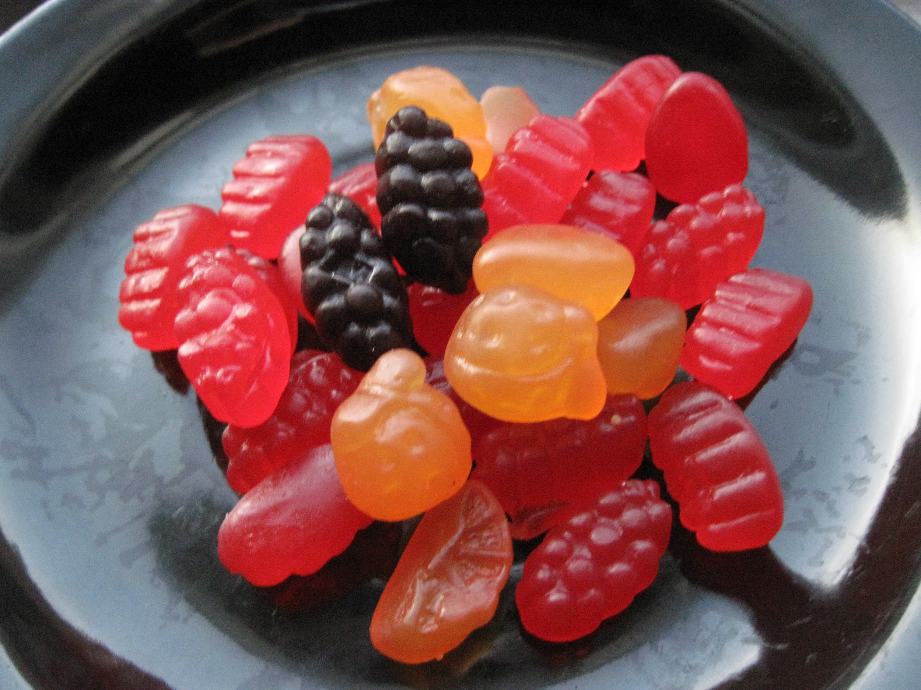
You can also visit the library to purchase healthy snacks after lunch!

Slide 4
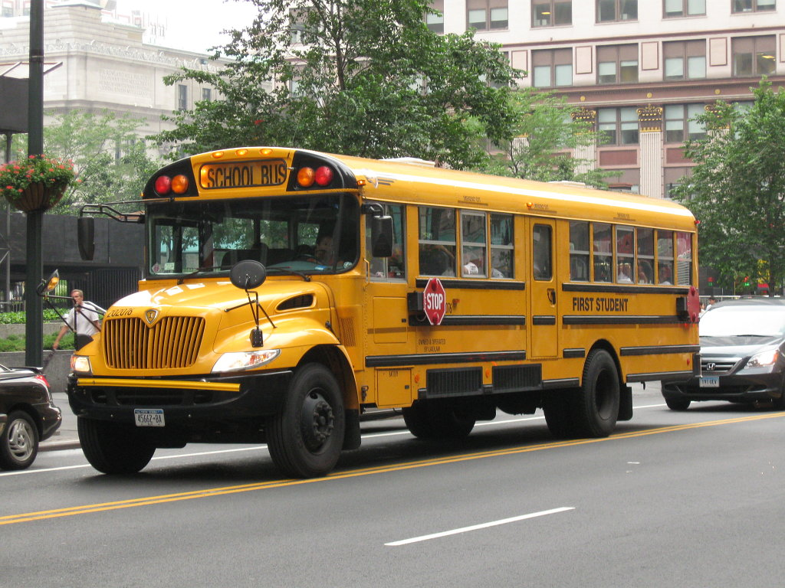
After School
We are open until 3:35 everyday.
Do not miss your bus!!

Slide 5
Late books
In elementary school if your book was late, you could not check out a new one.
In middle school if your book is late, you can not check out a new one plus, you may not be allowed to attend dances, or field trips.

Slide 6
Library is sorted by:
Fiction
A made up story. There are many different genres including; mystery, historical, humorous, realistic, and ghost stories, to name a few.
Nonfiction
the branch of literature comprising works of narrative prose dealing with or offering opinions or conjectures
upon facts and reality, including biography, history, and the essay (opposed to fiction and distinguished from poetry and drama).

Slide 7
Questions??

Slide 8
Lets have a great year!

Slide 9
Works Cited
http://www.readerpants.net/search/label/Library%20Orientation%20Ideas

